Slide 1

Modules Summary Discussion – Q&A
CR 6.4
Private and Confidential

Slide 2

Importance of Nutrition
1
Copyright: iCare Life Pte. Ltd., Singapore : This document must not be copied or shared or circulated without the consent of iCare Life and/or its affiliates.

Slide 3

Importance of Nutrition
2
Copyright: iCare Life Pte. Ltd., Singapore : This document must not be copied or shared or circulated without the consent of iCare Life and/or its affiliates.

Slide 4
Summary
The desire to have food is called appetite
Food provides us with nutrition
The key nutrients of food are:
Carbohydrates for quick energy
Fats for additional energy
Proteins for growth and body repair
Vitamins and minerals for all round health and immunity
Fluids supply us with water
Water transports nutrients, regulates our body temperature, and helps in eliminating waste
Our food should be a balance of all the required nutrients and fluids
3
Notes:
The desire to have food is called appetite
Food provides us with nutrition
The key nutrients of food are:
Carbohydrates for quick energy
Fats for additional energy
Proteins for growth and body repair
Vitamins and minerals for all round health and immunity
Fluids supply us with water
Water transports nutrients, regulates our body temperature, and helps in eliminating waste
Our food should be a balance of all the required nutrients and fluids

Slide 5
Any Questions?
4
Notes:
Q1. Does having all the nutrients mean eating many different types of food?
Ans: There are several food items that are a good source of nutrients. For example, milk is a good source of carbohydrates, fats, and protein. Similarly, egg is a good source of both proteins and fats. So, if you choose what you eat wisely, it is not required to have many different types of food to get all the required nutrients. However, for the sake of variety and keeping a healthy appetite, it is good to eat different types of foods at different times of the day.

Slide 6
Maintaining Nutritional Food Value
5
Copyright: iCare Life Pte. Ltd., Singapore : This document must not be copied or shared or circulated without the consent of iCare Life and/or its affiliates.

Slide 7
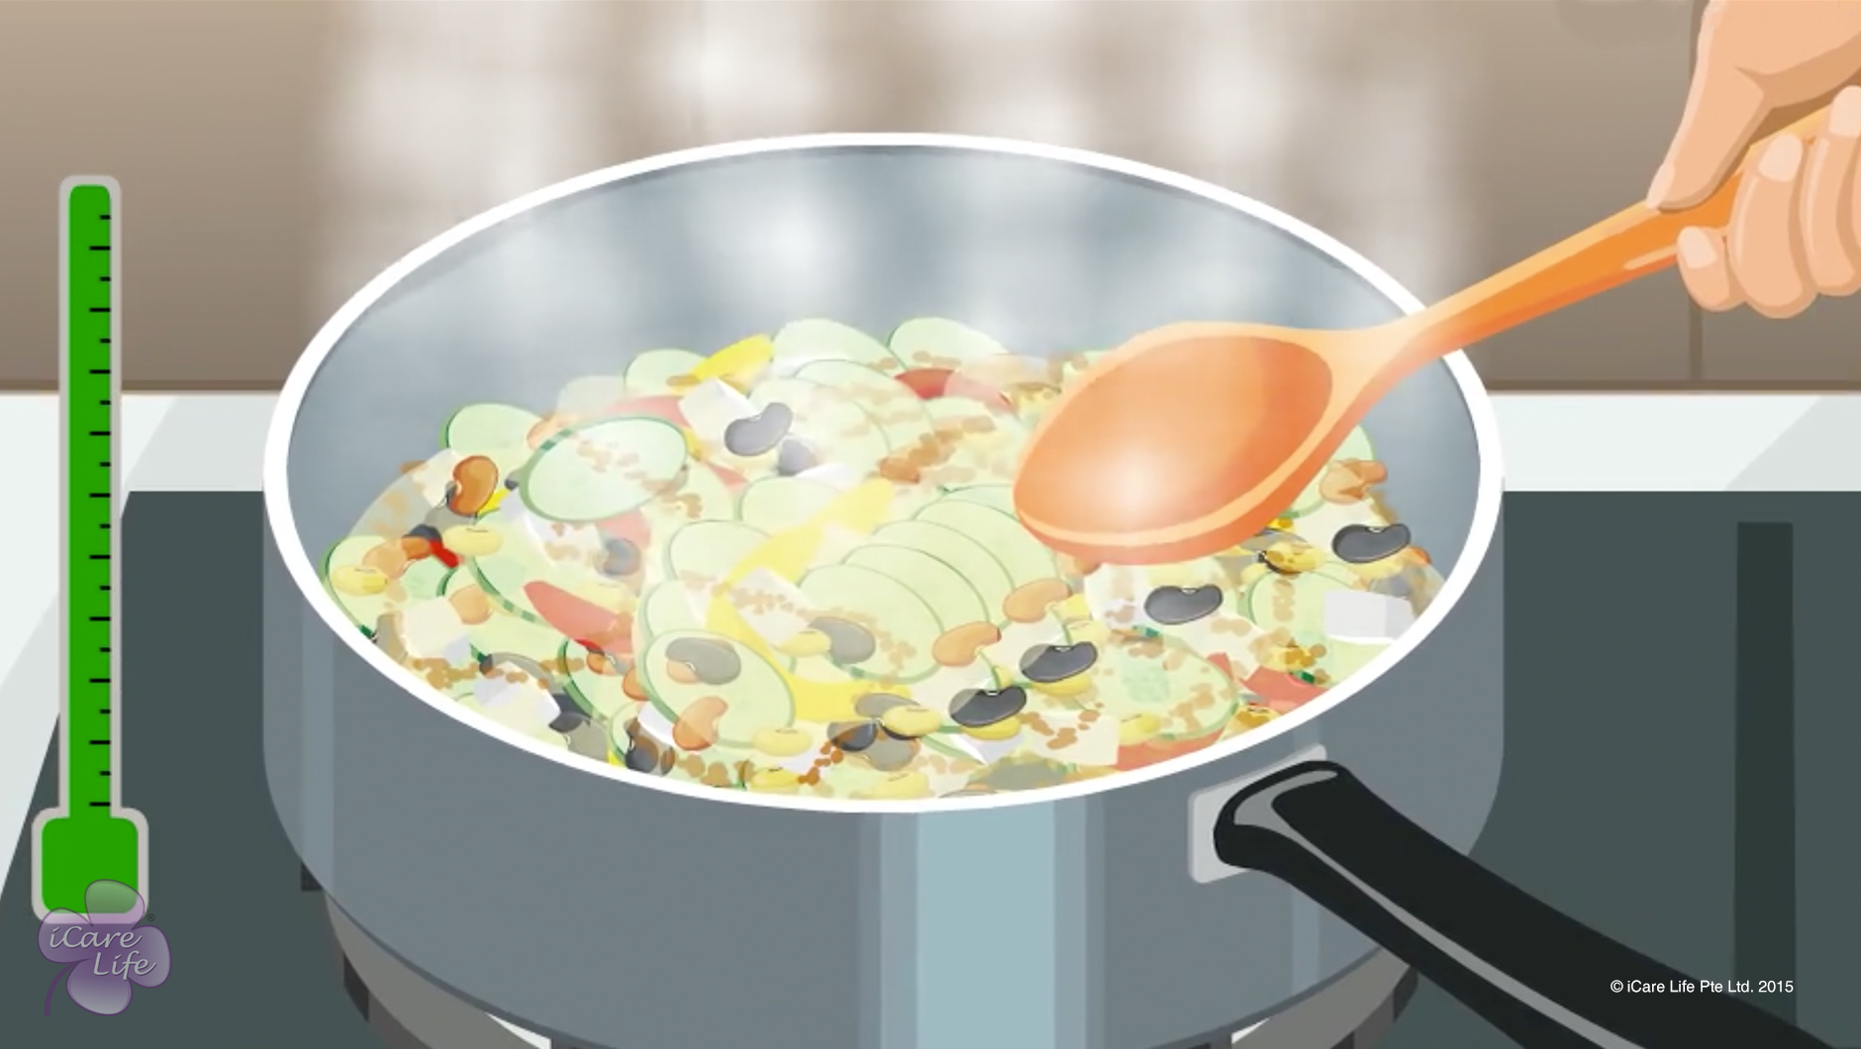
Maintaining Nutritional Food Value
6
Copyright: iCare Life Pte. Ltd., Singapore : This document must not be copied or shared or circulated without the consent of iCare Life and/or its affiliates.

Slide 8
Summary
To get maximum nutrition from food:
Buy fresh produce
Stock food only for a few days
Use sautéing and steaming for cooking food
Limit boiling and baking food
Avoid deep frying and microwave cooking
Do not reuse oil for frying and sautéing
Do not refreeze thawed food
Check best before date on packaged food
Follow storage and usage instructions on food packages
7
Notes:
To get maximum nutrition from food:
Buy fresh produce
Stock food only for a few days
Use sautéing and steaming for cooking food
Limit boiling and baking food
Avoid deep frying and microwave cooking
Do not reuse oil for frying and sautéing
Do not refreeze thawed food
Check best before date on packaged food
Follow storage and usage instructions on food packages

Slide 9
Any Questions?
8
Notes:
Q1. Can all kinds of food be prepared by sautéing and steaming?
Ans: No. Sautéing and steaming are cooking techniques suitable only for certain types of food preparations. For preparing other kinds of food, different methods of cooking need to be used. You may not be able to adapt each recipe for techniques of steaming and sautéing. However, you can try and include more dishes that can be cooked using these methods.

Slide 10
Nutritional Issues of the Elder
9
Copyright: iCare Life Pte. Ltd., Singapore : This document must not be copied or shared or circulated without the consent of iCare Life and/or its affiliates.

Slide 11
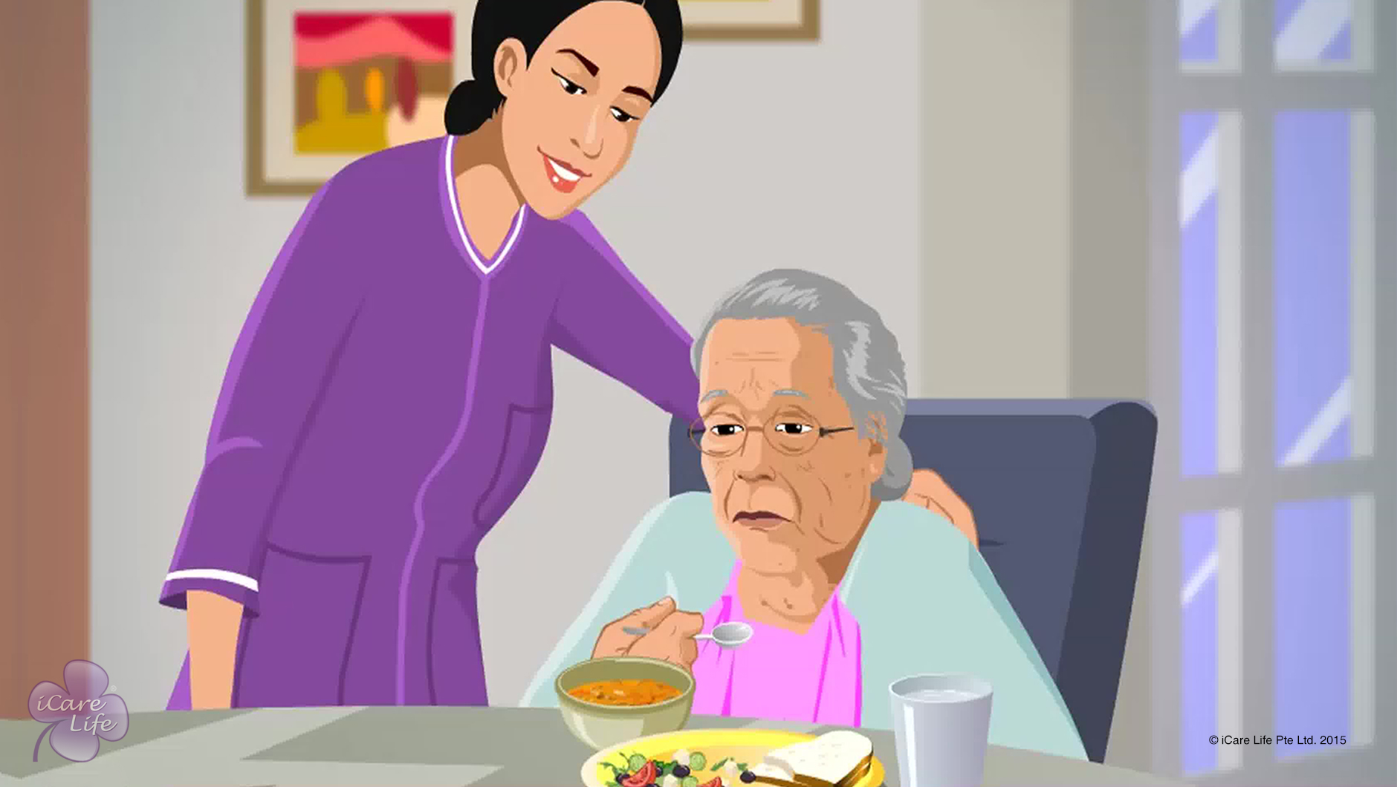
Nutritional Issues of the Elder
10
Copyright: iCare Life Pte. Ltd., Singapore : This document must not be copied or shared or circulated without the consent of iCare Life and/or its affiliates.

Slide 12
Post-Module Activity
Prepare and Present
Digestive Issues | Dental Problems
Loss of Appetite | Lack of Nutrition
Copyright: iCare Life Pte. Ltd., Singapore : This document must not be copied or shared or circulated without the consent of iCare Life and/or its affiliates.
Notes:
Divide the participants into four groups. Allocate one of the nutritional issues mentioned in the above table to each group. Allow the participants some time, say ten minutes, to discuss within the group and come up with a short talk or presentation on the issue, with respect to elders. One or more members from each group will then come forward and present a short talk or presentation on the nutritional issue highlighting its reasons and possible solutions.

Slide 13
Summary
If the elder has poor digestion, administer medications as prescribed by the doctor
For elders with dental problems, ensure that their dentures fit well. Grate or blend hard to chew food
If the elder has a low appetite, ensure correct food texture and try to improve its taste
To ensure proper nutrition, serve a balanced diet supported by food supplements
12

Slide 14
Any Questions?
13
Notes:
Q1. Are food supplements medicines?
Ans: Food supplements are not medicines. Food supplements provide a percentage of the daily recommended requirement of one or more essential nutrients. They can be in the form of pills, capsules, powders, or syrups and are normally derived from natural sources.

Slide 15
Food and Fluid intake
14
Copyright: iCare Life Pte. Ltd., Singapore : This document must not be copied or shared or circulated without the consent of iCare Life and/or its affiliates.

Slide 16

Food and Fluid intake
15
Copyright: iCare Life Pte. Ltd., Singapore : This document must not be copied or shared or circulated without the consent of iCare Life and/or its affiliates.

Slide 17
Summary
To eat healthy and stay healthy:
Eat only as much as required
Have five to six small meals spread over the day
Eat raw vegetables as salad with cooked food
Have fruits as snacks between meals
Have 2-3 liters of water every day
Eat your food in a relaxed manner
Keep having fluids throughout the day
Eat healthy foods like fresh fruits and vegetables, whole grains, legumes, milk and milk products, dry fruits, eggs, chicken, and lean meat
16
Copyright: iCare Life Pte. Ltd., Singapore : This document must not be copied or shared or circulated without the consent of iCare Life and/or its affiliates.
Notes:
To eat healthy and stay healthy:
Eat only as much as required
Have five to six small meals spread over the day
Eat raw vegetables as salad with cooked food
Have fruits as snacks between meals
Have 2-3 liters of water every day
Eat your food in a relaxed manner
Keep having fluids throughout the day
Eat healthy foods like fresh fruits and vegetables, whole grains, legumes, milk and milk products, dry fruits, eggs, chicken, and lean meat

Slide 18
Summary
To eat healthy and stay healthy:
Include garlic, honey, and coconut in your food
Have steamed, baked, or sautéed food
Avoid deep fried, oily, very spicy, and microwave cooked food
Avoid foods like tobacco, alcohol, refined flour, white sugar, and excessive tea and coffee
17
Notes:
To eat healthy and stay healthy:
Include garlic, honey, and coconut in your food
Have steamed, baked, or sautéed food
Avoid deep fried, oily, very spicy, and microwave cooked food
Avoid foods like tobacco, alcohol, refined flour, white sugar, and excessive tea and coffee

Slide 19
Any Questions?
18
Notes:
Q1. Why is it better to eat five small meals than having three large meals in a day?
Ans: When you have three large meals in a day – breakfast, lunch and dinner – there is a large time gap between meals. This can leave you feeling hungry and weak during mid-morning and evening. The long gap increases you appetite and you often tend to overeat at the next mealtime. By having five small meals during the day, you are eating after every few hours. This keeps away hunger pangs and keeps you energetic throughout the day. This also controls the urge to overeat at meal times. Research shows that having several small meals during the day also helps keep your weight under control.

Slide 20
Body Hygiene of the Elder
19
Copyright: iCare Life Pte. Ltd., Singapore : This document must not be copied or shared or circulated without the consent of iCare Life and/or its affiliates.

Slide 21
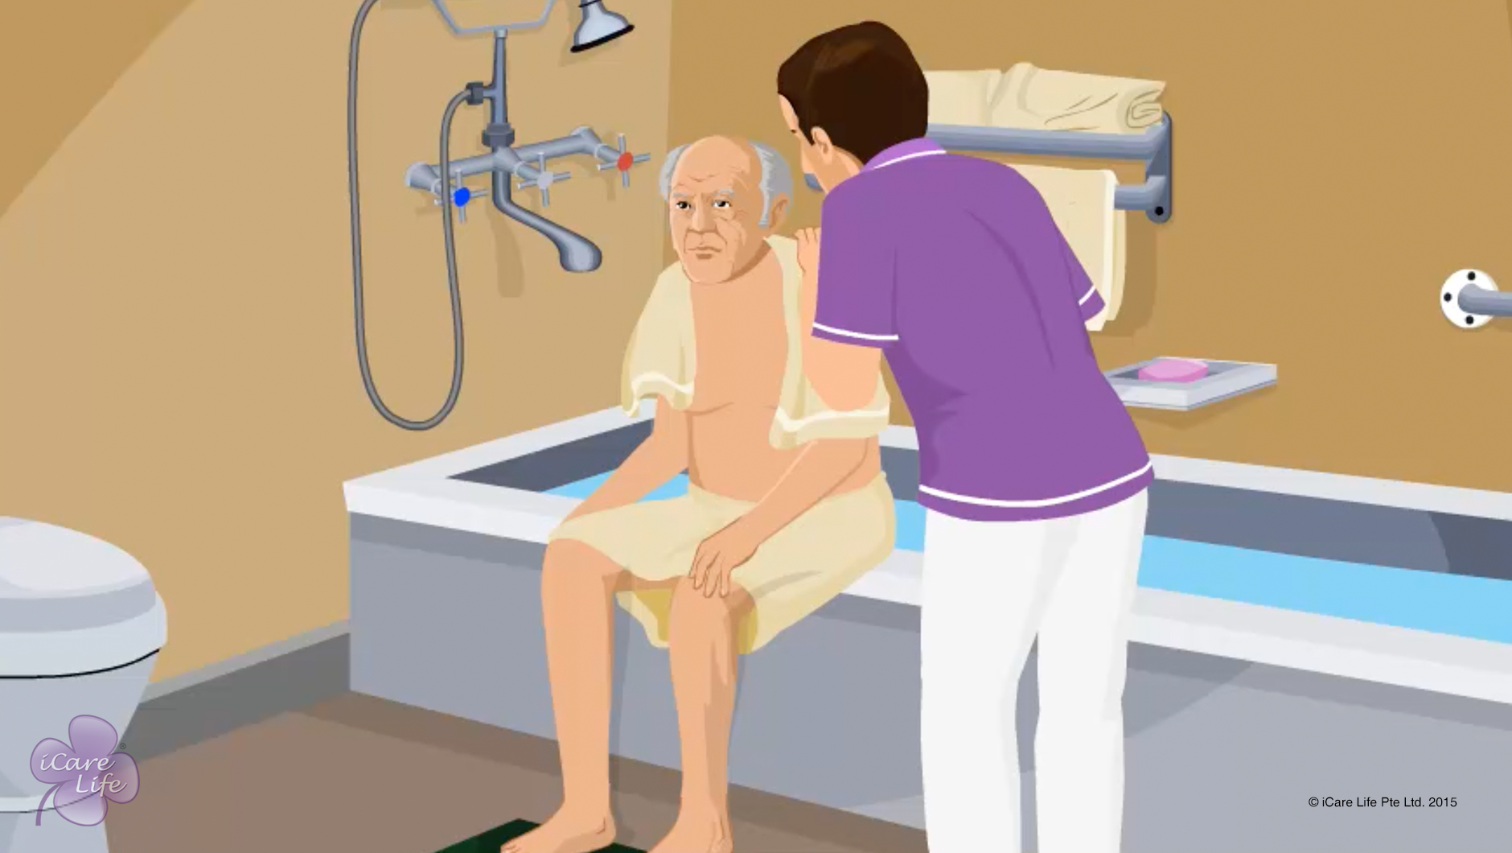
Body Hygiene of the Elder
20
Copyright: iCare Life Pte. Ltd., Singapore : This document must not be copied or shared or circulated without the consent of iCare Life and/or its affiliates.

Slide 22
Summary
Wash the elder’s body with soap and water
Dry the elder’s body thoroughly
Lubricate the elder’s skin with a moisturizer
Wash the elder’s hair regularly
Brush the elder’s teeth twice a day
Clean the elder’s nose once or twice a day
Clean the external ear or pinna, every day with a cotton bud
Encourage the elder to wash hands several times in a day
Cut the elder’s nails short
21
Copyright: iCare Life Pte. Ltd., Singapore : This document must not be copied or shared or circulated without the consent of iCare Life and/or its affiliates.
Notes:
Wash the elder’s body with soap and water
Dry the elder’s body thoroughly
Lubricate the elder’s skin with a moisturizer
Wash the elder’s hair regularly
Brush the elder’s teeth twice a day
Clean the elder’s nose once or twice a day
Clean the external ear or pinna, every day with a cotton bud
Encourage the elder to wash hands several times in a day
Cut the elder’s nails short

Slide 23
Any Questions?
22
Notes:
Q1. Are there elderly persons who may refuse to have a bath daily?
Ans. Yes, there are many such people who refuse to take a bath on a daily bath. Some of the reasons may be as follows: -
(a) Depression
(b) Trying to avoid control of younger generation on themselves
(c) Decreased sense of sight and smell of sweat.
(d) Loss of memory- they forget as when did they last have a bath
(e) Feeling uncomfortable or unsafe in bathrooms
(f) A sense of uneasiness of being bathed by someone else
Q2. What may happen if body hygiene is not maintained properly?
Ans. Poor hygiene has a negative impact on the health of the elder as it allows the bacteria, viruses, and fungi to breed. It may aggravate the illness of the elder or create a new illness in them. Poor hygiene may take away the friends and family of the elder which will further make his emotional health poor. Poor hygiene can also infect the caregiver. On the other hand high standards of hygiene will help keep the elder in a happy and a healthy state.

Slide 24
Caring for an Immobilised Elder
23
Copyright: iCare Life Pte. Ltd., Singapore : This document must not be copied or shared or circulated without the consent of iCare Life and/or its affiliates.

Slide 25
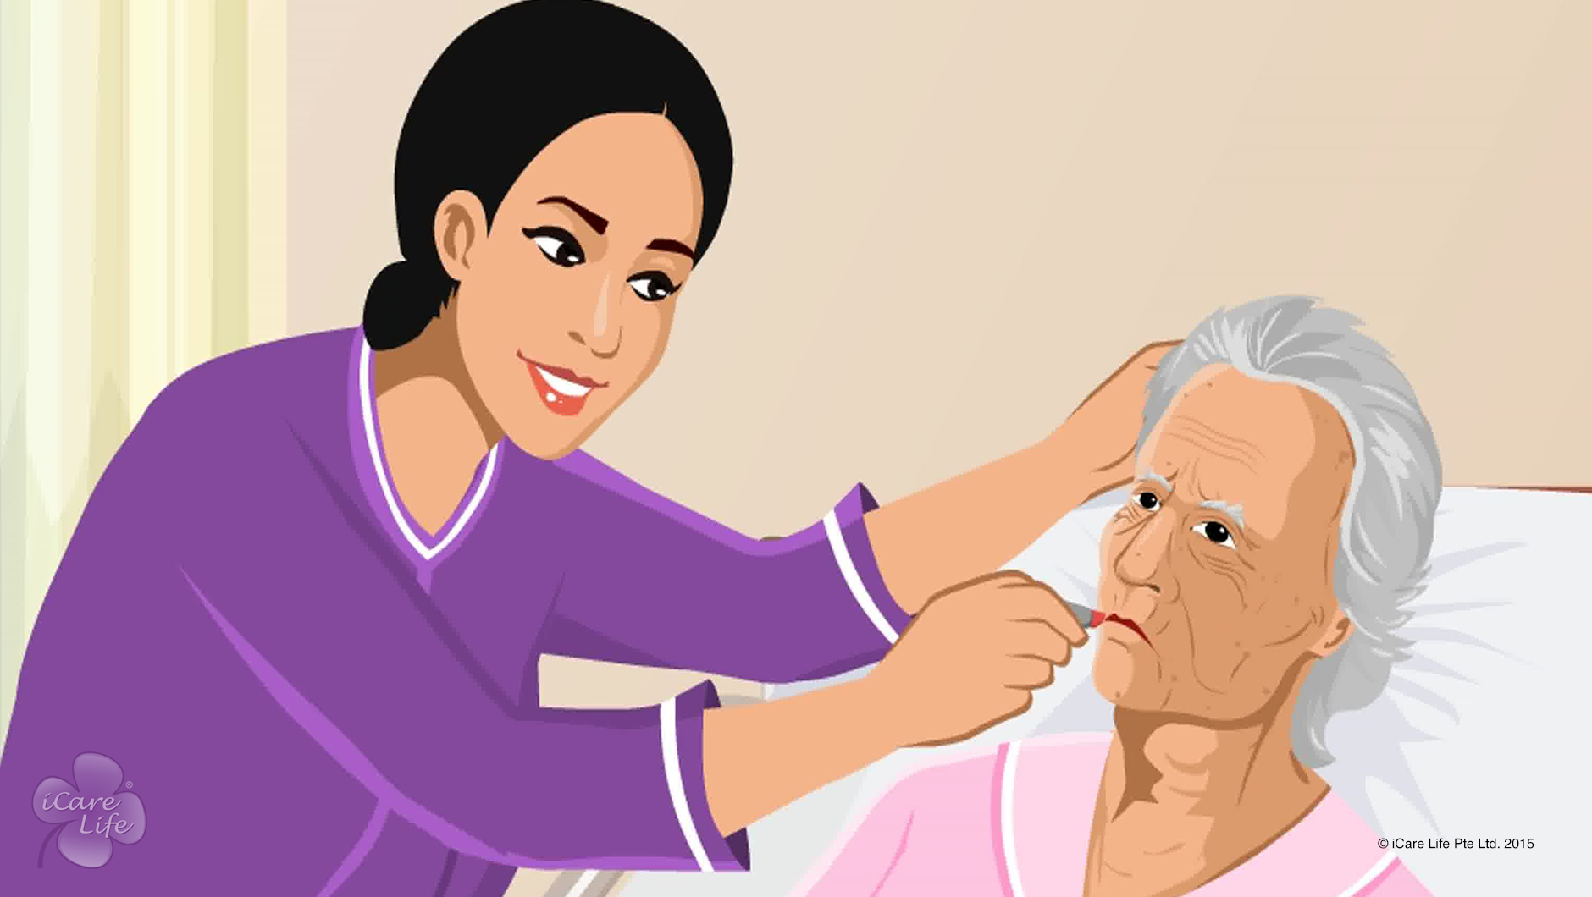
Caring for an Immobilised Elder
24
Copyright: iCare Life Pte. Ltd., Singapore : This document must not be copied or shared or circulated without the consent of iCare Life and/or its affiliates.

Slide 26
Post-Module Activity
Visit to a Hospital / Clinic
25
Copyright: iCare Life Pte. Ltd., Singapore : This document must not be copied or shared or circulated without the consent of iCare Life and/or its affiliates.
Notes:
Set up an appointment with a nursing home or an old age home where elders with mobilization difficulties are taken care of.
Ask the caregiver to show the class participants how an immobilized elder is fed, changed, and taken care of during the course of the day.
Ask the class participants to observe carefully and make notes wherever necessary.

Slide 27
Summary
To facilitate meals for a bedridden elder, use appropriate feeding equipment and serve liquidized food with thick consistency
Follow proper care and hygiene practices to make bed toileting comfortable
Give the person a periodic bed bath
Change their clothes every day
Comb the elder’s hair every day; encourage the elder to wear makeup and cologne
For a male elder, shave the elder in bed as required; if the elder keeps a beard, trim it as required
To prevent bed sores, keep changing the elder’s position every few hours and keep the elder’s skin dry
Perform passive exercises for the elder
Wash the person’s hair regularly; consider using a hair washing tray
Help the elder brush their teeth and clean their tongue twice a day; if the elder wears dentures, brush them like natural teeth twice a day
Regularly clean the external ear
26
Notes:
To facilitate meals for a bedridden elder, use appropriate feeding equipment and serve liquidized food with thick consistency
Follow proper care and hygiene practices to make bed toileting comfortable
Give the person a periodic bed bath
Change their clothes every day
Comb the elder’s hair every day; encourage the elder to wear makeup and cologne
For a male elder, shave the elder in bed as required; if the elder keeps a beard, trim it as required
To prevent bed sores, keep changing the elder’s position every few hours and keep the elder’s skin dry
Perform passive exercises for the elder
Wash the person’s hair regularly; consider using a hair washing tray
Help the elder brush their teeth and clean their tongue twice a day; if the elder wears dentures, brush them like natural teeth twice a day
Regularly clean the external ear

Slide 28
Summary
Help the elder keep their nose clean
If the elder under your care uses a nasal- gastric tube or Ryle's tube for feeding, clean the part of the tube coming out of the nose
Cut the elder’s nails once a week or more frequently, depending on how fast they grow
Provide the elder with books and magazines of their choice
Try to get a television put in front of their bed
Involve them in brain activities and games
Encourage visits by family and friends
Encourage the elder to share their life stories with you; listen patiently and appreciate their achievements
Try to engage in intellectually stimulating conversations with the elder
If the elder shares any anxieties or negative feelings, listen patiently and try to show the positive aspects of their life
Share jokes and try to keep the elder in good cheer
27
Notes:
Help the elder keep their nose clean
If the elder under your care uses a nasal- gastric tube or Ryle's tube for feeding, clean the part of the tube coming out of the nose
Cut the elder’s nails once a week or more frequently, depending on how fast they grow
Provide the elder with books and magazines of their choice
Try to get a television put in front of their bed
Involve them in brain activities and games
Encourage visits by family and friends
Encourage the elder to share their life stories with you; listen patiently and appreciate their achievements
Try to engage in intellectually stimulating conversations with the elder
If the elder shares any anxieties or negative feelings, listen patiently and try to show the positive aspects of their life
Share jokes and try to keep the elder in good cheer

Slide 29
Any Questions?
28
Notes:
Q1. What should I do when the bedridden elder wants to perform tasks like eating, themselves?
Ans. You should let the elder perform such tasks, while taking care of their health and safety.

Slide 30
Giving a Bed Bath
29
Copyright: iCare Life Pte. Ltd., Singapore : This document must not be copied or shared or circulated without the consent of iCare Life and/or its affiliates.

Slide 31
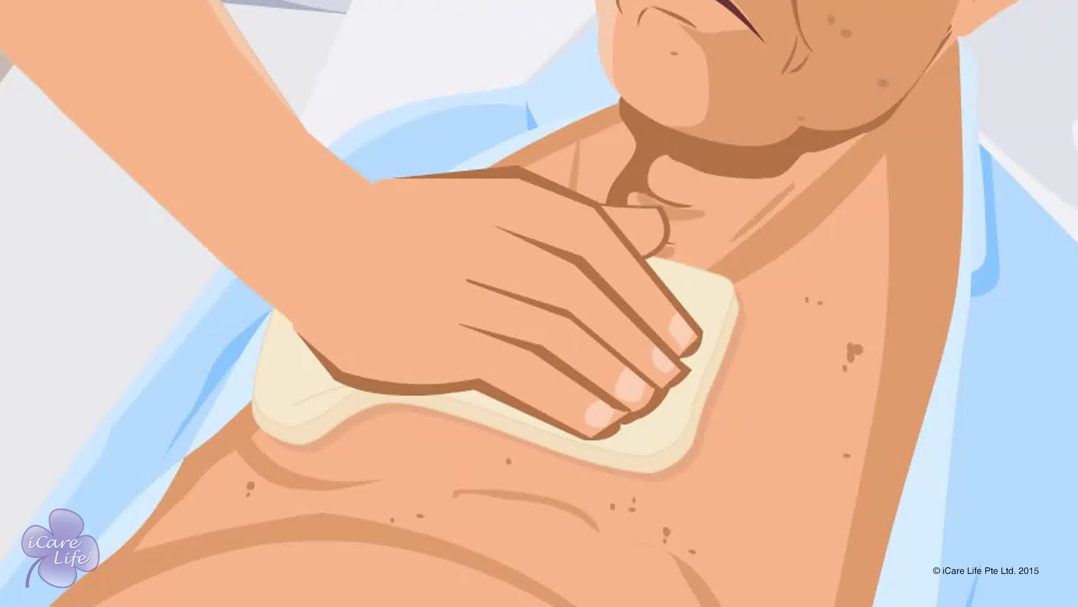
Giving a Bed Bath
30
Copyright: iCare Life Pte. Ltd., Singapore : This document must not be copied or shared or circulated without the consent of iCare Life and/or its affiliates.

Slide 32
Post-Module Activity
Practical Training
Copyright: iCare Life Pte. Ltd., Singapore : This document must not be copied or shared or circulated without the consent of iCare Life and/or its affiliates.
Notes:
The participants are given a live demonstration of giving a bed bath to bedridden people (you could use dummies) and washing their hair by trained caregivers. The ideal place for this would be an old people’s home or a nursing home. Fix a prior appointment for the activity and inform the participants of the location and timings for the demonstration.
During the demonstration, participants should be asked to assist the caregiver performing the demonstration. If possible, one by one the participants can give bed baths and wash hair of bedridden people (or dummies) under the supervision of a trained caregiver.

Slide 33
Summary
While giving a bed bath:
Be patient and caring
Maintain the person’s dignity and privacy
Keep the person warm
Use water of moderate temperature
Wash the face area first
Dry and cover each washed area before washing the next area
Rinse the washcloth after washing each area
Wash all skin fold areas thoroughly
Wash the groin area at the last
Apply body lotion to moisturize the person’s skin
32
Notes:
While giving a bed bath:
Be patient and caring
Maintain the person’s dignity and privacy
Keep the person warm
Use water of moderate temperature
Wash the face area first
Dry and cover each washed area before washing the next area
Rinse the washcloth after washing each area
Wash all skin fold areas thoroughly
Wash the groin area at the last
Apply body lotion to moisturize the person’s skin

Slide 34
Summary
To wash a person’s hair:
Make the person lie on the edge of the bed
Tilt the person’s head backwards
Use a folded towel to support the person’s neck
Place an empty bucket under the person’s head
Wet the person’s hair
Apply shampoo
Rinse the person’s hair and scalp thoroughly
Wrap the person’s hair in a towel and dry gently
33
Notes:
To wash a person’s hair:
Make the person lie on the edge of the bed
Tilt the person’s head backwards
Use a folded towel to support the person’s neck
Place an empty bucket under the person’s head
Wet the person’s hair
Apply shampoo
Rinse the person’s hair and scalp thoroughly
Wrap the person’s hair in a towel and dry gently

Slide 35
Any Questions?
34
Notes:
Q1. Should I use soap while giving a bed bath to a person?
Ans: You may add a few drops of a mild liquid soap to the water used for bed bath. However, generally it is not recommended to use soap while giving bed bath to a person. This is because soap requires a lot of water to be washed away completely. If it is not washed away, it can cause dryness and irritation to the person’s skin.

Slide 36
Dressing the Elder
35
Copyright: iCare Life Pte. Ltd., Singapore : This document must not be copied or shared or circulated without the consent of iCare Life and/or its affiliates.

Slide 37
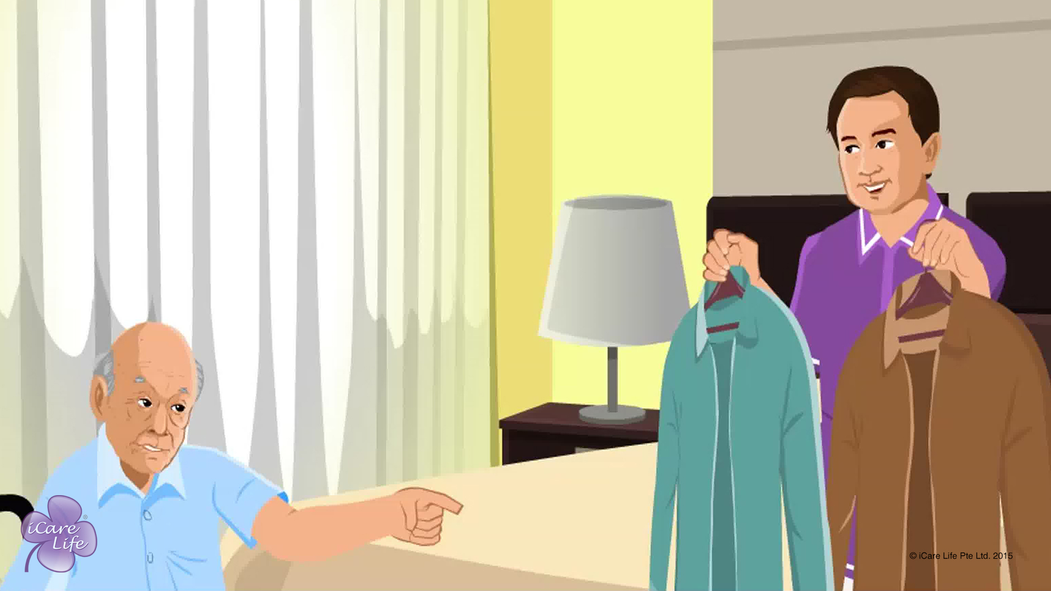
Dressing the Elder
36
Copyright: iCare Life Pte. Ltd., Singapore : This document must not be copied or shared or circulated without the consent of iCare Life and/or its affiliates.

Slide 38
Post-Module Activity
Let’s Practice!
Copyright: iCare Life Pte. Ltd., Singapore : This document must not be copied or shared or circulated without the consent of iCare Life and/or its affiliates.
Notes:
Arrange for a human dummy, a bed, and some clothes and shoes. Begin by a demonstration conducted by a trained caregiver to help dress a partially and fully dependent elder. The demonstration should include the steps of personal grooming.
Later the participants should be invited one by one to practice how to assist a partially and fully dependent elder to dress. The trained caregiver should give feedback on the correct way of supporting the elder and dressing the elder while causing minimal discomfort to the person.

Slide 39
Summary
To help an elder dress:
Change the elder’s clothes at least once a day
Make sure the clothes are clean and well ironed
Suggest clothes appropriate for the weather and occasion
Involve the elder in choosing their clothes
Respect the elder’s privacy and dignity while dressing them
Encourage the elder to be as independent as possible
For independent elders:
Store the clothes at an easily accessible shelf in the closet
Allow the elder privacy to dress
38
Notes:
To help an elder dress:
Change the elder’s clothes at least once a day
Make sure the clothes are clean and well ironed
Suggest clothes appropriate for the weather and occasion
Involve the elder in choosing their clothes
Respect the elder’s privacy and dignity while dressing them
Encourage the elder to be as independent as possible
For independent elders:
Store the clothes at an easily accessible shelf in the closet
Allow the elder privacy to dress

Slide 40
Summary
For partially dependent elders:
Take out clothes and lay them where the elder can reach them easily
Encourage the elder to start dressing from stronger side of the body
Help them dress the weaker side of the body
Choose front open clothes with buttons or zippers
Help the elder tie shoelaces
Help the elder comb hair and wear makeup and cologne of their choice
For fully dependent elders:
Lay the clothes beside the elder
Start undressing from the weaker side of the body
Start dressing from the stronger side of the body
Undress and dress one part of the body at a time
Comb the elder’s hair and apply makeup and cologne of their choice
39
Notes:
For partially dependent elders:
Take out clothes and lay them where the elder can reach them easily
Encourage the elder to start dressing from stronger side of the body
Help them dress the weaker side of the body
Choose front open clothes with buttons or zippers
Help the elder tie shoelaces
Help the elder comb hair and wear makeup and cologne of their choice
For fully dependent elders:
Lay the clothes beside the elder
Start undressing from the weaker side of the body
Start dressing from the stronger side of the body
Undress and dress one part of the body at a time
Comb the elder’s hair and apply makeup and cologne of their choice

Slide 41
Any Questions?
40
Notes:
Q1. Why should I assist the elder when we want the person to be as independent as possible while dressing?
Ans: We want the elder to be as independent as possible. This does not mean the elder does not need your help at all. This means that you should provide help only when required and asked for. Do not try to do everything for the elder. Be patient and allow the elder to do as much of the dressing part as comfortable for the person. The objective is to make the elder feel more capable and have a sense of self sufficiency. This, in no way, takes away your responsibility for the elder’s comfort and safety.

Slide 42
Providing Wheelchair Assistance
41
Copyright: iCare Life Pte. Ltd., Singapore : This document must not be copied or shared or circulated without the consent of iCare Life and/or its affiliates.

Slide 43
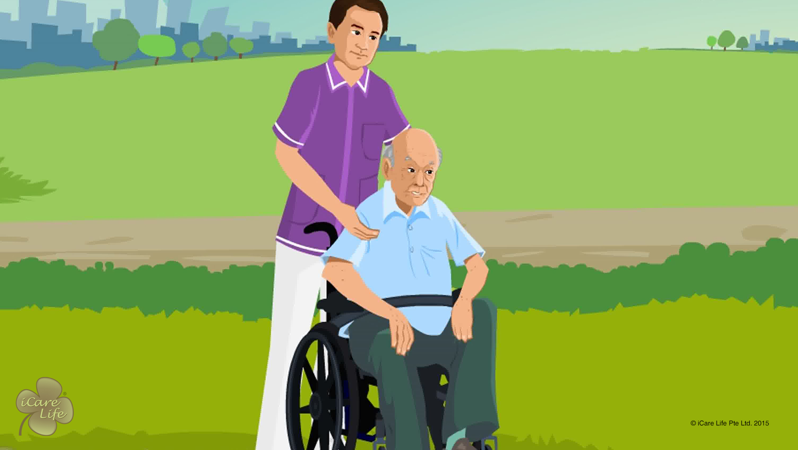
Providing Wheelchair Assistance
42
Copyright: iCare Life Pte. Ltd., Singapore : This document must not be copied or shared or circulated without the consent of iCare Life and/or its affiliates.

Slide 44
Post-Module Activity
Let’s Practice
Copyright: iCare Life Pte. Ltd., Singapore : This document must not be copied or shared or circulated without the consent of iCare Life and/or its affiliates.
Notes:
Take the participants to a home/nursing home which is modified to suit the needs of an elder confined to the wheelchair. A trained caregiver can demonstrate the use of a vertical platform lift and stairway lift. Fix a prior appointment for the activity and inform the participants of the location and timings for the demonstration.
Ask participants to practice performing various tasks. Give appropriate feedback.

Slide 45
Summary
At the entrance of the house, ensure a smooth path, a ramp or vertical platform lift, and the threshold thickness of one and half inches or less
Inside the house, corridors should be clutter-free and spacious
Tile, floorboards, or low pile carpet are ideal for free movement of wheelchair
A vertical platform lift or stairway lift can be used to move the elder up and down the stairs
The bathrooms may have a walk-in bathtub, lower threshold for shower and a shower chair, railings, and raised toilet seat
44
Notes:
At the entrance of the house, ensure a smooth path, a ramp or vertical platform lift, and the threshold thickness of one and half inches or less
Inside the house, corridors should be clutter-free and spacious
Tile, floorboards, or low pile carpet are ideal for free movement of wheelchair
A vertical platform lift or stairway lift can be used to move the elder up and down the stairs
The bathrooms may have a walk-in bathtub, lower threshold for shower and a shower chair, railings, and raised toilet seat

Slide 46
Summary
When the elder is sitting in the wheelchair:
Ensure the seat belt is fastened
Ensure that the elder’s weight is evenly balanced
Ensure that the elder’s feet are placed on the footrests
When wheelchair is stationary with elder, lock the wheels
When outdoors, understand the surroundings, terrain, and manoeuvring wheelchair through paths
Use facilities meant for disabled, such as ramps, parking, and restrooms to ensure smooth experience for elder
45
Notes:
When the elder is sitting in the wheelchair:
Ensure the seat belt is fastened
Ensure that the elder’s weight is evenly balanced
Ensure that the elder’s feet are placed on the footrests
When wheelchair is stationary with elder, lock the wheels
When outdoors, understand the surroundings, terrain, and manoeuvring wheelchair through paths
Use facilities meant for disabled, such as ramps, parking, and restrooms to ensure smooth experience for elder

Slide 47
Any Questions?
46
Notes:
FAQs
Q1. How do I get the elder into the car?
You can use a mechanical lift or slipping board to help the elder into a car. Fold the wheelchair and place in the car.
Q2. How precautions should I take when moving the wheelchair down the ramp?
Control the speed at which the wheelchair moves down the ramp. Put your weight behind the wheelchair.
Q3. What modifications can I suggset in the house if the elder insists on being independent?
The cabinets and the counter tops in the kitchen can be lower. Also, the switch boards can be moved lower to allow easy access.
Q4. If the elder insists on manoeuvring the wheelchair themselves, what should I do?
A. Allow the elder to manoeuvre the wheelchair, but keep a close eye and stay near the wheelchair, especially when outdoors.

Slide 48


